Slide 1


Team Up
Football tactics is not complex anymore

Slide 2

Data Overload
02
Team Up Challenges‏
Complex Decision Making
Incomplete Information
1
03
Football generates an immense amount of data
Football is a complex game, and picking the best players to start can be tricky because it means thinking about many things
Coaches frequently have restricted knowledge about players' present conditions

Slide 3
Working Demo
Adaptability
Objectivity
Efficiency
Team Up solutions ‏
.
..
..
..
..
Maximizing Performance
02
01
..
AI models can consider an extensive range of variables simultaneously
AI can swiftly adapt to changing circumstances
03
04
AI models base their recommendations exclusively on data, eliminating the influence of human biases and emotions.
Automating the lineup selection process saves valuable time for coaches

Slide 4
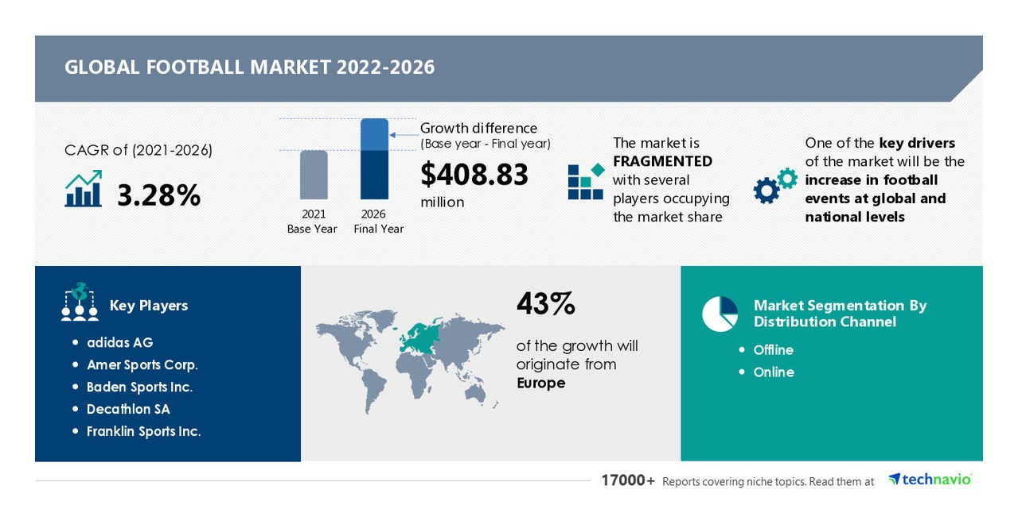
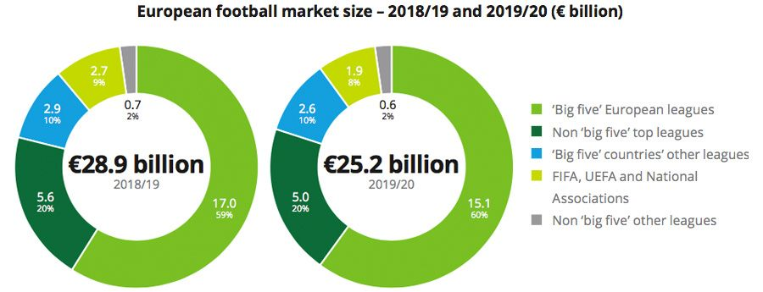
Market size
Market size

Slide 5
Revenue Stream
Subscription Model
Licensing
Data Partnerships
Offer different subscription plans for clubs, media outlets, and analysts to access lineup predictions for various leagues and competitions.
Provide API access or licensing agreements to integrate the lineup prediction system into existing sports platforms, apps, or websites.
Collaborate with data providers or sports organizations to enhance the accuracy and coverage of the lineup prediction system.

Slide 6
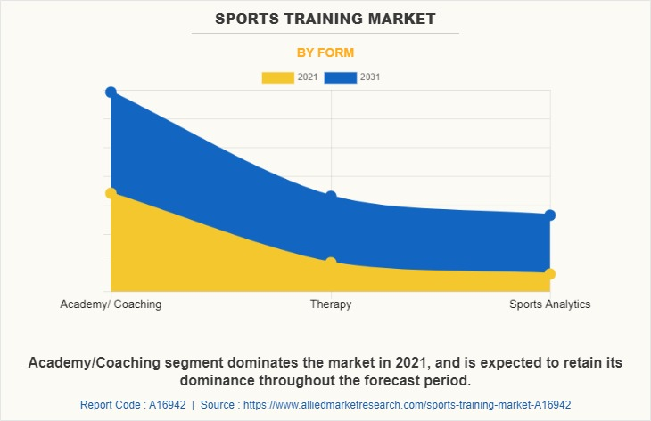
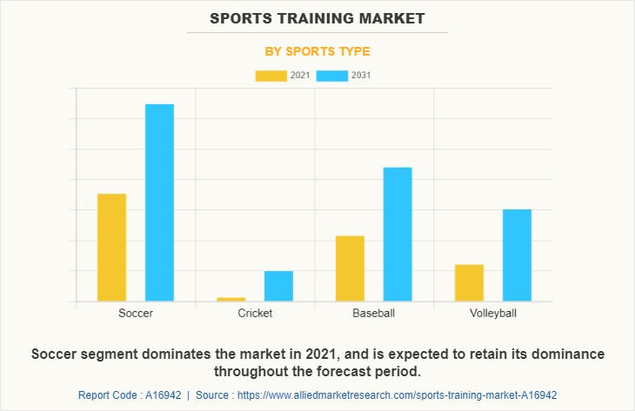
Next steps/Backlogs
Next steps/Backlogs
Based on these statistics, we decided to Produce some future plans, including: developing the site to include several sports fields and expanding its services provided to keep up with developments in the entertainment plan in 2030 vision.
Based on these statistics, we decided to Produce some future plans, including: developing the site to include several sports fields and expanding its services provided to keep up with developments in the entertainment plan in 2030 vision.

Slide 7


Website Demo
https://github.com/janasamra/gaia-TeamUp

Slide 8


Team Members‏
.
Ayat‏ Mohammed
Machine Learning - front end - product management
Mohammed Alwan
Machine Learning - product management
Samaher Ahmed
Business analyzer‏
Deema Saleh
UI/UX – graphic design – machine learning
Jana Ahmed
Machine Learning - front end
‏
Nourhan mohamed abdelraouf
‏ Machine Learning – full stack

